Slide 1
Coupled Oscillations
31st August 2020

Slide 2
Two coupled pendulums
Consider a system of two identical simple pendulums, each of mass m and length l, coupled by a linear spring of force constant s.
The natural length of the spring is equal to the separation of the masses at zero displacement.
Let x and y be the displacements of the masses at an instant of time t.
The spring is stretched or compressed depending on whether x > y or y > x.
When y = x, the sprint is neither stretched nor compressed.
Notes:
There are two forces acting on each pendulum; namely, the spring force and the gravity.

Slide 3
Two coupled pendulums (contd.)
Generally, there are two forces acting on each pendulum:
1. gravitational force (mg) acting
to each mass in the downward
direction
2. spring force (F) acting to each mass
in the opposite direction
F_{spring}
F_{spring}
mg
mg
y
x

Slide 4
Gravitational force only
θ
l
mg
Notes:
The component mgsinθ causes the torque and makes the object to swing
While the mgcosθ just cancels the tension T in the string.

Slide 5
Spring force (+gravitational force)
In addition to the gravitational force, the force due to the spring connected to the masses has to be considered.
However, if the spring is neither compressed nor stretched, no spring force involves in the analysis. The spring is intact.
This spring introduces additional forces on the two masses when it is either stretched or compressed.
If y > x, the spring is compressed.
If y < x, the spring is stretched.

Slide 6
If the spring is compressed:
Assume that the spring obeys the Hooke’s law, the equation of motions become
F_{spring}
F_{spring}
mg
mg
y
y>x
x

Slide 7
If the spring is stretched:
Assume that the spring obeys the Hooke’s law, the equation of motions become
F_{spring}
F_{spring}
mg
mg
y
y<x
x

Slide 8
Two coupled pendulums (contd.)
Given that the natural vibration frequency of each pendulum is given by .
Finally, the equations of motion of the two pendulums, for small oscillations in a plane, are
In order to find out the effect of coupling on each pendulum, these equations must be solved for x and y.
Notes:
In case of x > y, the spring is stretched and the spring forces acting on left pendulum and right pendulum are pointing to the right and left hand sides respectively.
This gives the spring force for the left pendulum to be +s(x-y) and for the right pendulum to be –s(x-y).
However, we end up with the same equation of motion no matter what!

Slide 9
The Decoupling Method
Note that each DE in the previous slide contains two variables (x and y).
To overcome the interaction between variables, the decoupling method is used.
This is a quick and easy but can only be used in symmetric systems,.e.g. characteristics of pendulums are the same.
Firstly try adding the equations of motion and interpret the result in terms of a new variable.
Secondly try subtracting the equations of motion and interpret the result in terms of a new variable.

Slide 10
What happens when trying to add and subtract the equations of motion?
Adding the equation of motion
Subtracting the equation of motion
Note : The two new variable describes two fundament motion of the oscillating system.

Slide 11
Normal Coordinates and Normal Modes
The addition and subtraction of equations of motion, e.g. X = x + y and Y = x – y make the equations of motion to contain only one dependent variable.
The equations of motion become simple harmonic in terms of X and Y as follows,
X and Y are called normal coordinates and they associate with simple harmonic equations. As a result, each harmonic oscillator has its own way of vibration or normal mode.
Notes:
The simplification is made for having only on variable in each equation of motion. Also the new arrangement allows an easy way to find a solution.
The way we did here is equivalent to the analysis of the superposition of the motion of both pendulums.

Slide 12
What does the relative motion of X look like ?
The equation of motion actually describes the SHM with a single natural frequency equal to (g/l)^{1/2}.
Note that the term of spring force is absent in the equation of motion.
The spring is neither compressed nor stretched.
https://www2.physics.ox.ac.uk/sites/default/files/2012-09-04/normalmodes_iandii_pdf_96820.pdf

Slide 13
What does the relative motion of Y look like?
The equation of motion actually describes the SHM with a single natural frequency equal to (g/l + 2s/m )^{1/2}.
Note that the term of spring force is present in the equation of motion.
The spring is either compressed or stretched.
https://www2.physics.ox.ac.uk/sites/default/files/2012-09-04/normalmodes_iandii_pdf_96820.pdf

Slide 14


Normal mode frequencies
The “out of phase” mode of vibration (x = -y)
The normal mode frequency is given by
The two pendulums are oscillating harmonically at this frequency.
The sprig affects the motion and the coupling is effective.
The “in phase” mode of vibration ( x = y)
The normal mode frequency is given by
which is the same as that of either
pendulum oscillating in isolation.
The effect of spring is absent.
http://physics-animations.com/Physics/English/link_txt.htm

Slide 15
The matrix method of finding normal modes
Starting the method by guessing the normal modes frequency ω of the coupled pendulums.
Recall the original equations of motion of the system
Assuming that the pendulums start from the rest and the solutions of the differential equations may be written as
A and B are displacement amplitudes of x and y.
Notes:
This method is a bit more involved but in principle it can be used to solve any set up.

Slide 16
The matrix method of finding normal modes (contd.)
Substituting the expected solution into the equations of motion and giving
Therefore,
This can be arranged in the form of eigenvalue equation with ω² as an eigen value and column vector with components A and B as eigen vector.

Slide 17
The matrix method of finding normal modes (contd.)
Rearrange the previous eigenvalue equation as,
These equations have a non-zero solution if and only if the determinant of the matrix vanishes; that is, if
There are two solutions which are composed of
These give the amplitude ratios A/B = 1 for in phase mode and A/B = -1 for out of phase mode, respectively.

Slide 18
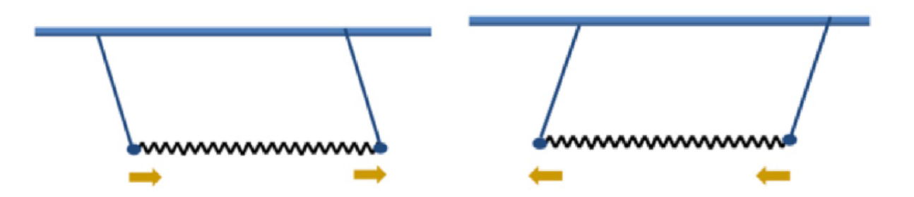
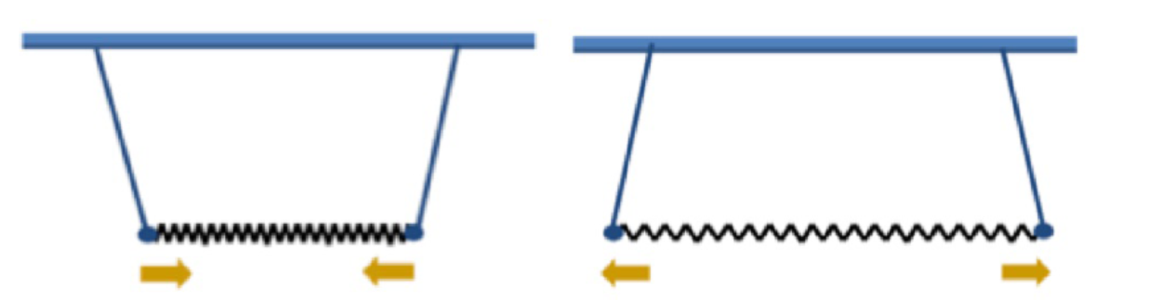
What are the amplitude ratios A/B?
Referring to the eigen value equation,
The amplitude ratio A/B can be determined from
The ratio A/B = 1 for in phase mode when
The ratio A/B = -1 for out of phase mode when
https://www2.physics.ox.ac.uk/sites/default/files/2012-09-04/normalmodes_iandii_pdf_96820.pdf

Slide 19
Problem : Find normal mode frequencies and amplitude ratio using matrix method
The spring constant for all springs are s.
m₁ = 2M; m₂ = M
x₂ > x₁
Determine normal mode frequencies
S
S
S
https://www2.physics.ox.ac.uk/sites/default/files/lecture3_4_pdf_20475.pdf

Slide 20
Solution
The equations of motion for each mass :
Because m₁ = 2M; m₂ = M, the above equations may be written as
By giving solutions
Notes:
The solution may be given as x1 = A1exp(iwt) and x2 = A2exp(iwt).
Once the solutions are substituted into the equation of motion, the same equation will be obtained.

Slide 21

Solution (contd.)
$$\left[\begin{matrix}\frac{s}{M}−ω^{2} & −\frac{s}{2M} \\ −\frac{s}{M} & \left(\frac{2s}{M}−ω^{2}\right)\end{matrix}\right]\left[\begin{matrix}A_{1} \\ A_{2}\end{matrix}\right]=\left[\begin{matrix}0 \\ 0\end{matrix}\right]$$
The eigenvalue equation is given as
The normal mode frequencies are
Determine the ratios of the amplitudes for each normal mode frequencies!

Slide 22
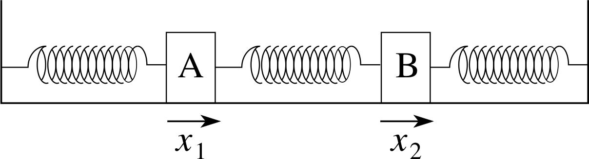
Revisit the coupled oscillators
S
S_{o}
S
m
m
http://www.met.reading.ac.uk/pplato2/h-flap/phys5_3.html
A system of two coupled oscillators of equal masses on a smooth horizontal surface is revisited.
Two springs connected to the rigid wall are identical and different from the one in the middle.
If the displacements of left and right masses are given as x₁ and x₂, respectively, the equation motion is given as :
Notes:
ปัญหาข้อนี้เหมือนกรณีที่เป็น double pendulum ต่างกันเพียงแต่ว่าแรงที่กระทำต่อมวลแต่ละก้อน เป็นแรงจากสปริงทั้งหมด
ในที่นี้ให้ x2 > x1

Slide 23
Finding the normal mode frequency by the decoupling method
By combining and subtracting the equations of motion, two equations of simple harmonic motion in which each equation contains only one dependent variable (normal coordinate) is obtained.
Given that
Two normal modes (described by X and Y) oscillate with two different frequencies ; i.e.
Notes:
Normal mode คือ รูปแบบการสั่นแบบ simple harmonic motion ที่บรรยายโดย normal coordinates
คำพวกนี้จะมาเป็น package ประกอบด้วย normal mode, normal coordinate, normal mode vibration, normal mode frequency

Slide 24
Normal mode coordinates : X and Y
General solutions for equations of motion describing the normal modes may be written as
Where X₀, Y₀, φ₁, φ₂ are constants and can be determined by the four initial conditions
The corresponding solutions for the original coordinates x₁ and x₂ are given by
Notes:
X1 และ x2 ใช้บรรยายการเคลื่อนที่ของมวลแต่ละก้อน

Slide 25
Normal modes (contd.)
Each of the two modes is identified as the lowest mode (with a frequency of ω₁) and the highest mode (with a frequency of ω₂) .
A single normal mode can be excited if the initial condition such that either X(t) =0 or Y(t) =0 for all t is made.
What to be considered include
(1) To excite only the lowest mode (Y(t) =0 for all t)
(2) To excite the highest mode (X(t) =0 for all t)
(3) To excite a linear combination of normal modes

Slide 26
Lowest normal mode excitation
Let
This gives which are valid for Y₀ = 0 for any φ₂
This suggests that Y(t) = 0 all the times and x₁(t) = x₂(t) all the times, also.
Example : Choose initial conditions
As a result, .
The displacements of the two masses become
In phase
Notes:
With Y(0), this implies that two masses are displaced. Each one of them is displaced by a distance of a.
Due to the dX/dt = 0, this suggests φ1 = 0 and X0 = 2a . Therefore x(t) = 2acos w1t
X1 = x2 suggests both masses oscillate in phase.

Slide 27
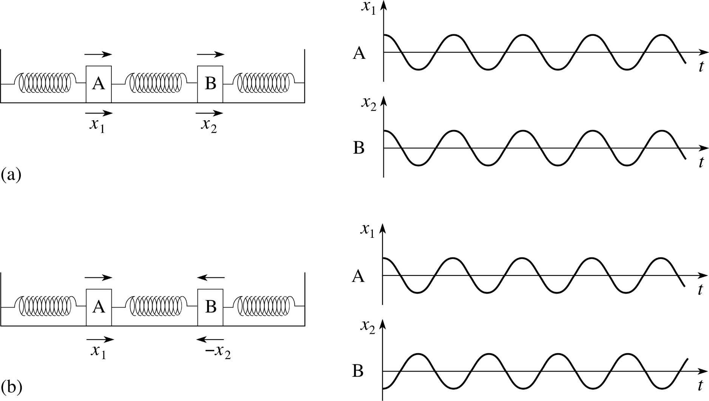
Oscillating displacement of the lowest normal mode
http://www.met.reading.ac.uk/pplato2/h-flap/phys5_3.html

Slide 28
Highest normal mode excitation
Let
This gives which are valid for X₀ = 0.
This suggests that X(t) = 0 all the times and x₁(t) = -x₂(t) all the times, also.
Example : Choose initial conditions
As a result, .
The displacements of the two masses become
Out of phase

Slide 29
Oscillating displacement of the highest normal mode
http://www.met.reading.ac.uk/pplato2/h-flap/phys5_3.html

Slide 30
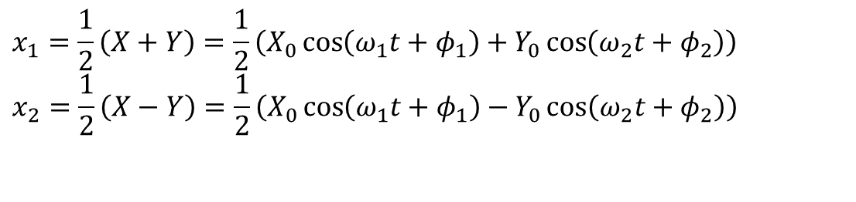

Linear combination of normal modes excitation
Given that one of the masses is displaced, so that the system is not in a normal mode.
The initial conditions are
This translates to
This gives the expressions of the normal coordinates as follows,
$$x_{1}=\frac{1}{2}\left(X+Y\right)=\frac{1}{2}\left(X_{0}\cos\left(ω_{1}t+φ_{1}\right)+Y_{0}\cos\left(ω_{2}t+φ_{2}\right)\right) \\ x_{2}=\frac{1}{2}\left(X−Y\right)=\frac{1}{2}\left(X_{0}\cos\left(ω_{1}t+φ_{1}\right)−Y_{0}\cos\left(ω_{2}t+φ_{2}\right)\right)$$
$$X\left(t\right)=a\cos\left(ω_{1}t\right) \\ Y\left(t\right)=a\cos\left(ω_{2}t\right)$$
Substitute these into
The oscillation of x₁ and x₂ can be clearly seen in the next page!

Slide 31
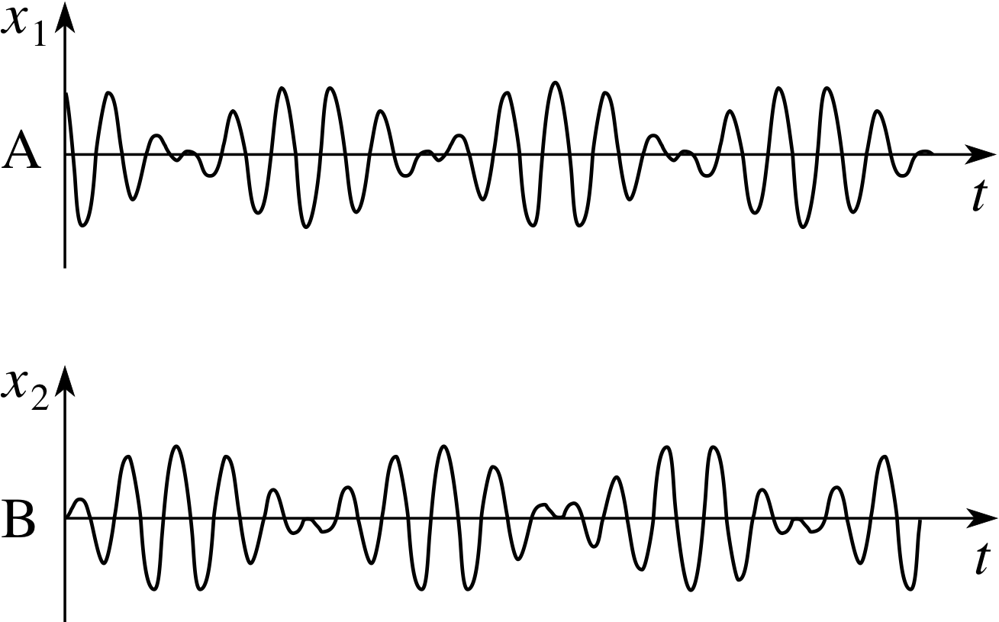
Linear combination of normal modes excitation (contd.)
Therefore, the displacement of each mass can be written as
Or
Amplitude terms
http://www.met.reading.ac.uk/pplato2/h-flap/phys5_3.html

Slide 32
Energy exchange
After release (t > 0), there is an energy exchange between the two masses.
In short, the x₂ displacement mass acquires all the energy of the x₁ displacement mass which is stationary when x₂ is vibrating with amplitude a but the energy is then returned to the mass originally displaced.
The important point to recognize is that although individual masses may exchange energy, there is no energy exchange between the normal modes.

Slide 33
Coupled oscillations of a loaded string
n = a number of masses
y_{r} = vertical displacement of rth mass
a = an equal distance between masses
equilibrium
Assumptions
1. Masses only move in the vertical direction.
2. The displacements from the equilibrium positions are small.
3. The gravitational force is ignored.
Notes:
n จำนวนก้อน mass ทั้งหมด

Slide 34
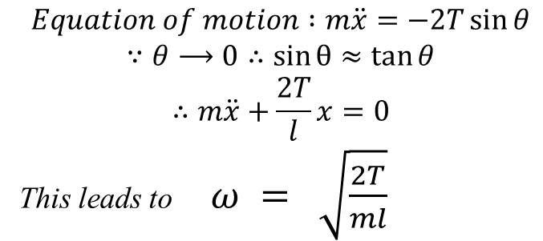
Recall the equation of motion
A mass m is at the center of a light string of length 2l fixed at both ends under a constant tension T.
All assumptions mentioned in the previous slide are applied here.
Derive the equation of motion!
θ
$$Equation of motion :m\ddot{x}=−2T\sin{θ}$$
$$∵θ⟶0∴\sin{θ}≈\tan{θ}$$
$$∴m\ddot{x}+\frac{2T}{l}x=0$$
This leads to $ω = \sqrt{\frac{2T}{ml}}$

Slide 35
Coupled oscillations of a loaded string (contd.)
Equation of motion of the rth mass is given as
If, in a normal mode of oscillation of frequency ω, the time variation of y_{r} is simple harmonic about the equilibrium, the displacement of rth is
;A_{r} = maximum displacement
By substituting the solution for each term into the equation of motion, the relation so called fundamental equation is written as
This equation is used to determined ω which is the frequency of the normal mode.
Notes:
จะ derive สมการการเคลื่อนที่ได้ต้องประมาณว่า tension ของ string ทางด้านซ้ายและทางด้านขวาของมวลที่ r เท่ากัน และมุม θ1 และ θ2 มีค่าน้อยๆ ดังนั้น sinθ≈tanθ

Slide 36
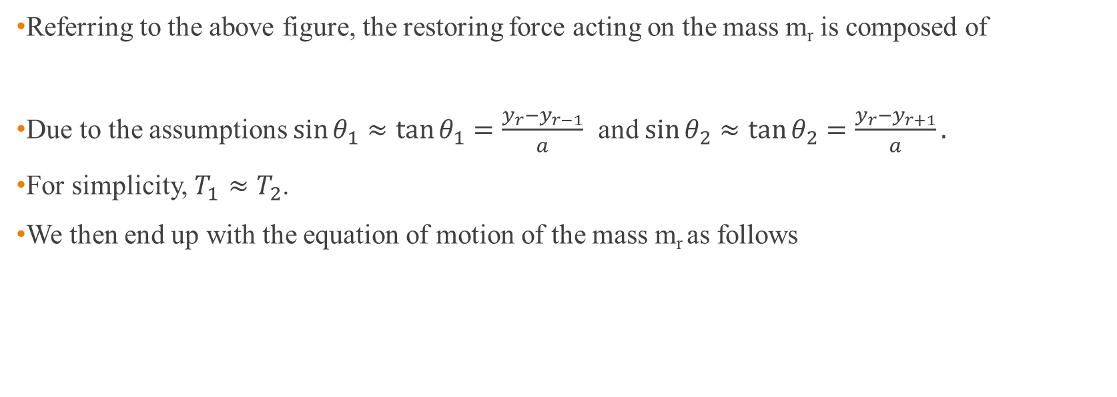

Referring to the above figure, the restoring force acting on the mass m_{r} is composed of
Due to the assumptions $\sin{θ_{1}≈\tan{θ_{1}=\frac{y_{r}−y_{r−1}}{a}}}$ and $\sin{θ_{2}≈\tan{θ_{2}=\frac{y_{r}−y_{r+1}}{a}}}.$
For simplicity, $T_{1}≈T_{2}$.
We then end up with the equation of motion of the mass m_{r} as follows
$${−T}_{1}\sin{θ_{1} and {−T}_{2}\sin{θ_{2}}}$$

Slide 37
Problem : determine the normal mode frequency using the fundamental equation
In order to determine the normal mode frequency, boundary conditions at both fixed ends have be considered. They are
First, when n = 1, one mass on a string of length 2a. Only one equation is needed to solve for the normal mode frequency.
The normal mode frequency is found to be .
Second, when n = 2, two equations are set to solve for two normal mode frequencies which are .

Slide 38
First, when n = 1, one mass on a string of length 2a.
Recall the fundamental equation:
In this case, there is only one mass. Thus r is designated as “1”.
By applying the boundary conditions, we end up with A₀ = A₂ = 0.
This gives the normal mode frequency as

Slide 39
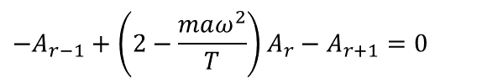


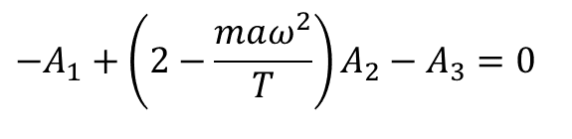
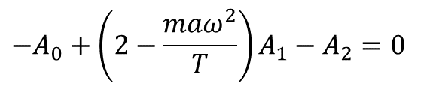
Second, when n = 2, two equations are set to solve for two normal mode frequencies
Recall the fundamental equation:
In this case, there are two masses. Two equations have to be set so as to solve for two normal mode frequencies.
With r = 1, the first equation is written as
With r = 2, the second equation is given as
Now solving the equations to obtain two normal mode frequencies as
What are the amplitude ratios?
$$−A_{r−1}+\left(2−\frac{maω^{2}}{T}\right)A_{r}−A_{r+1}=0$$
$$−A_{0}+\left(2−\frac{maω^{2}}{T}\right)A_{1}−A_{2}=0$$
$$−A_{1}+\left(2−\frac{maω^{2}}{T}\right)A_{2}−A_{3}=0$$

Slide 40
Normal vibrations of one and two masses
Normal vibration of a single mass m on string of length 2a
Normal vibration of two masses on a string length 3a
Note that the number of normal modes of vibration equals the number of masses.

Slide 41
Normal modes of oscillation of n coupled masses on the string
Recall the fundamental equation,
The equation can be rewritten as
The equation suggests that, for any particularly fixed value of the normal mode frequency ω (say ω_{j}) , the right-hand side of the equation is constant independent of r.
WE HAVE TO FIND A_{r} THAT SATISFIES THE REQUIRMENT AND BOUNDARY CONDITIONS.
Notes:
It is impractical to set n equations to determine n normal mode frequencies.
An alternative way is proposed to derive a formula that can be used to determine a normal frequency of n coupled oscillators.

Slide 42
Normal modes of oscillation of n coupled masses on the string (Contd.)
Let’s assume that the amplitude of the particle r is expressed in the form
By substituting this guess into the rearranged fundamental equation, the left-hand side of the equation becomes
This indicates that the assumed expression gives the requirement which is constant and independent of r.

Slide 43
Normal modes of oscillation of n coupled masses on the string (Contd.)
To find an appropriate θ, the boundary conditions A₀ = A_{n+1} = 0 has to be considered.
For the first boundary condition, A₀ = 0 , as r = 0. This clearly states that the first boundary condition is automatically satisfied.
For the second boundary condition, A_{n+1} = 0 , to be satisfied, (n+1)θ is an integral multiple of π, i.e.
As a result
This gives the amplitude of r th mass as
Notes:
ในที่นี้ j คือ index ของ normal mode frequency

Slide 44
Normal modes of oscillation of n coupled masses on the string (Contd.)
The allowed value of normal mode frequency ω_{j} is determined by
Where j may take the values j = 1, 2, …, n and
$$ω_{0}^{2}=\frac{T}{ma}$$

Slide 45
The wave equation
Recall the equation of motion of r th mass along the vertical direction
For a given normal mode, the displacement of the r th mass does not only depend on time t but also its position x on the string.
Rewrite the equation of motion of the r th mass in terms of partial derivatives,

Slide 46
The wave equation (Cont.)
To replace the discrete mass distribution with the continuous mass distribution, a ≡ Δx and Δx → 0,
The equation in the previous slide can be rewritten as

Slide 47
The wave equation (Contd.)
If m = ρδx where ρ is the linear density (mass per unit length) of the string, the masses must →0 as δx→0 to avoid infinite mass density. Thus
THIS IS THE WAVE EQUATION.
T/ρ has the dimensions of the square of a velocity which is the velocity of the wave propagates.
The solution for y at any particular point along the string is always that of a harmonic oscillation such as y = expi(ωt-kx).

Slide 48
Mass or inductance coupling
The following example is the electrical coupling system.
There are two LC oscillators coupled to one another via inductors.
Two sets of oscillators implies two normal mode frequencies.
I_{P}
I_{s}
primary
circuit
secondary
circuit
Inductively (mass) coupled LC circuits with mutual inductance M

Slide 49
Analysis of the coupling
The procedural analysis is similar to the analysis of the mechanical coupling.
According to the Kirchhoff’s loop rule; the combination of the voltages on the left LC oscillator can be written as

Slide 50
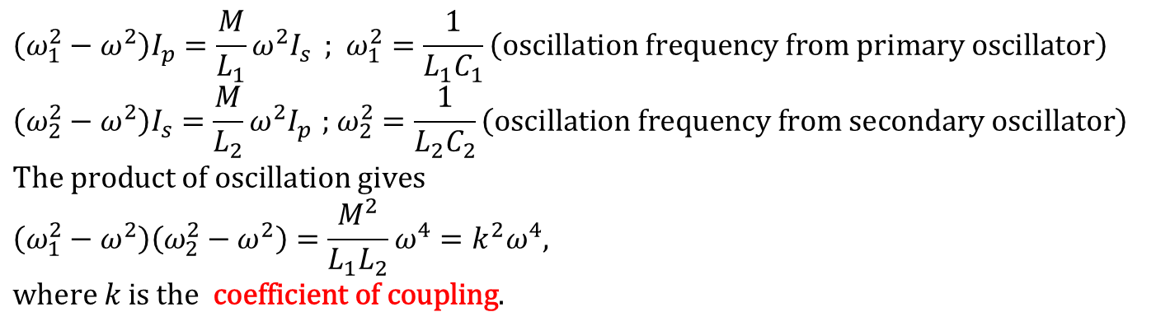
Analysis of the coupling (Cont.)
According to the Kirchhoff’s loop rule; the combination of the voltages on the right LC oscillator can be written as
Rearrange the voltage equations from both loops, we have
$$\left(ω_{1}^{2}−ω^{2}\right)I_{p}=\frac{M}{L_{1}}ω^{2}I_{s}^{}\text{; }ω_{1}^{2}=\frac{1}{L_{1}C_{1}}\left(\text{oscillation} \text{frequency} \text{from} \text{primary} \text{oscillator}\right) \\ \left(ω_{2}^{2}−ω^{2}\right)I_{s}=\frac{M}{L_{2}}ω^{2}I_{p}^{}\text{; }ω_{2}^{2}=\frac{1}{L_{2}C_{2}}\left(\text{oscillation} \text{frequency} \text{from} \text{secondary} \text{oscillator}\right) \\ \text{The} \text{product} \text{of} \text{oscillation} \text{gives} \\ \left(ω_{1}^{2}−ω^{2}\right)\left(ω_{2}^{2}−ω^{2}\right)=\frac{M^{2}}{L_{1}L_{2}}ω^{4}=k^{2}ω^{4}, \\ \text{where} k \text{is} \text{the} \text{coefficient} \text{of} \text{coupling}\text{.}$$

Slide 51
Coefficient of coupling k
The coefficient of coupling k relates the mutual inductance M to the self inductance L according to the following equation,
Because, in practice, M < (L₁L₂)^{1/2}, k < 1

Slide 52
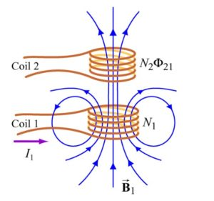
Review: mutual inductance, M
The current flowing in Coil 1 gives rise to a magnetic field B₁. Some of the magnetic field lines through coil 1 also passes through coil 2.
Φ₂₁ denotes the magnetic flux through one turn of coil 2 due to I₁.
By varying I₁ with time, there will be induced emf associated with the changing magnetic flux in the second coil according to Faraday’s law.
This gives
https://www.analogictips.com/mutual-inductance-transformers-emf-becomes-emi/
Notes:
ฟลักซ์แม่เหล็ก^{[1]} (อังกฤษ: magnetic flux) คือปริมาณเส้นแรงแม่เหล็กหรือจำนวนของเส้นแรงแม่เหล็กที่พุ่งจากขั้วหนึ่งไปยังขั้วหนึ่ง ของแท่งแม่เหล็ก มีหน่วยเป็น เวเบอร์ (Weber,Wb)

Slide 53
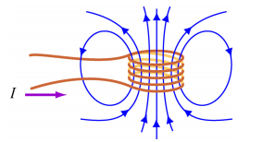
Review: self inductance L
In this case, the induced emf occurs upon itself due to the change of current in time.
Consider a coil consisting of N turns and carrying current I in the counterclockwise direction.
Suppose the current I changes with time, an induced emf will arise to oppose the change.
The induced current will flow ………. if dI/dt >0 and ………... if dI/dt < 0.
CW
CCW
Physically, the inductance L is a measure of an inductor’s “resistance” to the change of current; the larger the value of L, the lower rate of change of current.
http://web.mit.edu/viz/EM/visualizations/coursenotes/modules/guide11.pdf
Notes:
Clockwise, counter clockwise
กล่าวได้ว่า self inductance ก่อให้เกิด induced emf ในตัว inductor เอง (ต่างจาก mutual inductance ที่ก่อให้เกิด induced emf กับ inductor อื่น)
ซึ่งจาก Fararaday’s law induced emf เกิดจากการเปลี่ยนแปลงของ flux แม่เหล็กกับเวลา โดย induced emf ทำให้เกิด induced current ซึ่งเมื่อไหลผ่าน coil ก็ทำให้เกิดสนามแม่เหล็ก
ที่ต้านการเปลี่ยนแปลงสนามแม่เหล็กที่ทำให้มันเกิด

Slide 54
Normal mode frequencies of LC coupled circuit
Recall
Solving for ω that gives the frequencies at which energy exchange between the circuits allows the circuits to resonate.
That is ω₁ = ω₂ = ω₀.
The positive sign gives two frequencies :

Slide 55
Plot of the current amplitude vs frequency
Variation of the current amplitude in each circuit near the resonant frequency.
A small resistance prevents the amplitude at resonance from reaching infinite values.
Flattening of the response curve maximum gives “frequency band pass” coupling.

Slide 56
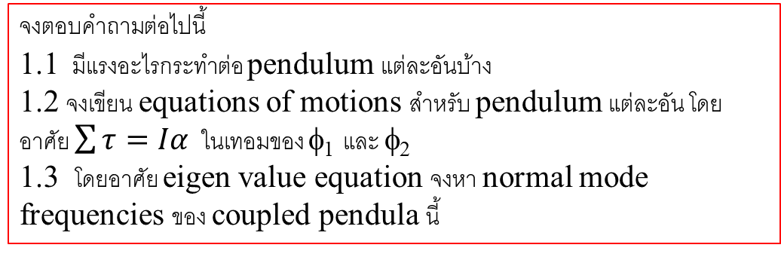
Homework#4
1. พิจารณาการเคลื่อนทีของ coupled pendula ที่เหมือนกันทุกอย่าง
รูปที่ 2 แสดง coupled pendula เมื่อเกิดการกระจัดเชิงมุม φ₁ และ φ₂ โดยที่ φ₁ > φ₂
จงตอบคำถามต่อไปนี้
1.1 มีแรงอะไรกระทำต่อ pendulum แต่ละอันบ้าง
1.2 จงเขียน equations of motions สำหรับ pendulum แต่ละอัน โดยอาศัย $\sum{τ=Iα}$ ในเทอมของ φ₁ และ φ₂
1.3 โดยอาศัย eigen value equation จงหา normal mode frequencies ของ coupled pendula นี้
รูปที่ 1 (ซ้ายมือ) แสดง pendulum และ ส่วนประกอบต่าง ๆ(ขวามือ) แสดง coupled pendula ขณะอยู่ที่ตำแหน่งสมดุล โดยกำหนดให้ L คือความยาวของ rod จากจุดหมุน (pivot) ถึงตำแหน่งจุดศูนย์กลางของก้อนมวล ในขณะที่ l เป็นระยะทางจากจุดหมุนถึงตำแหน่งที่ติดสปริงที่มีค่า stiffness s

Slide 57
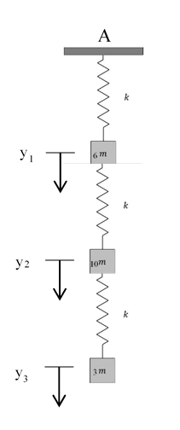
Homework#4 (cont.)
2. สปริงเบาสามเส้นเหมือนกันทุกประการมีมวลขนาด 6m 10m และ 3m ผูกติดอยู่ตามลำดับตามรูป เมื่อทำให้เกิดการสั่น มวลทั้งสามเคลื่อนที่ขึ้นลงตามแนวดิ่งที่ผ่านจุด A (โดยปลายจุด A ตรึงแน่น) กำหนดให้ k คือค่าคงตัวของสปริงทั้งสาม จงตอบคำถามต่อไปนี้
2.1 จงเขียนสมการการเคลื่อนที่ของมวลทั้งสาม
2.2 จงเขียนความถี่ของ free oscillation ω₀
2.3 จงหาความถี่ของ normal mode vibration ทั้งหมดที่เกิดขึ้นโดยให้ตอบในเทอมของ ω₀
(ไม่ต้องคิดผลเนื่องจาก gravitational force เนื่องจากไม่มีส่วนในแรงที่ทำให้เกิดการสั่น)

